Slide 1

Front End Development (FEND)
Session 2
© 2017 Udacity. All rights reserved.

Slide 2
Questions on previous session and HW

Slide 3
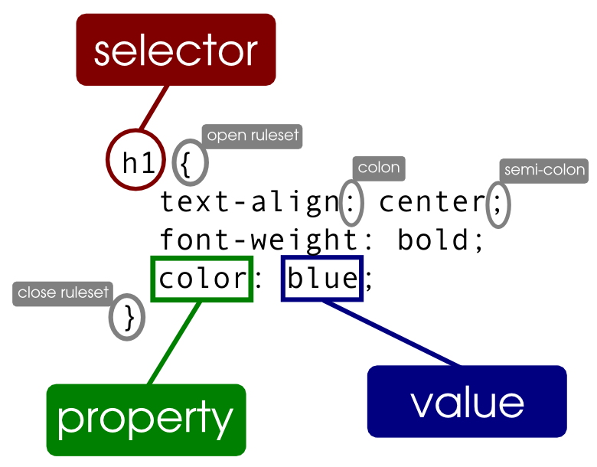
What is CSS?
1- Cascading style sheets
2- how to add css (inline, in head tag, external)
3- selectors (tags, id, classes)

Slide 4
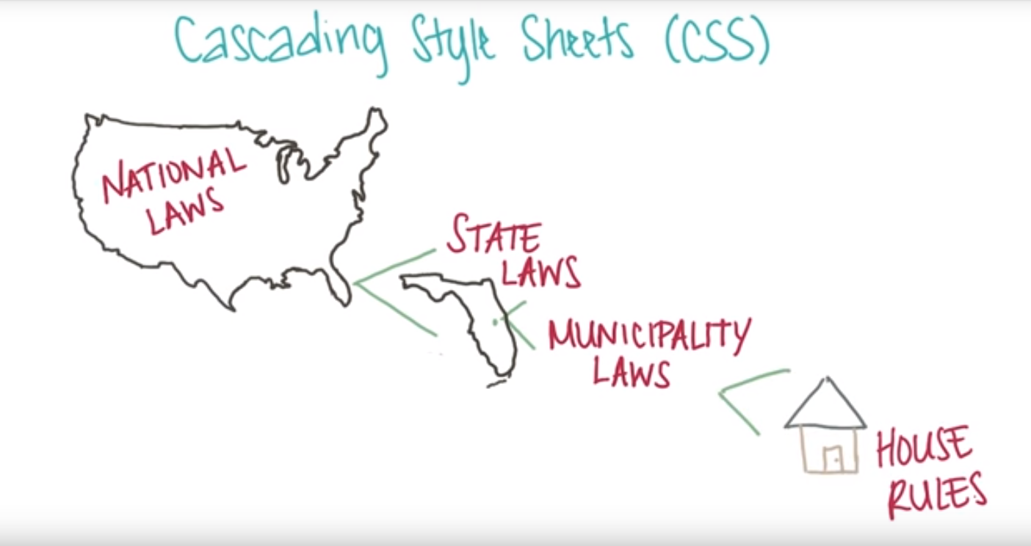
specificity

Slide 5
Code Comments
1 - HTML comment
A- <!-- comment -->
2- CSS comment
A- /* comment */

Slide 6
Developer tools

Slide 7
CSS units
1- Absolute (px,mm,in,cm)
2-Relative (%, em, vw,vh)

Slide 8
CSS Colors
1- color name property : value
2- rgb(0,0,0)
3-hexadecimal (#ff0022)

Slide 9
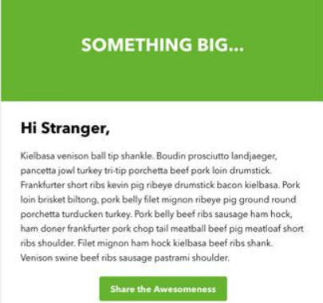
Exercise 1: code this mockup into a website

Slide 10
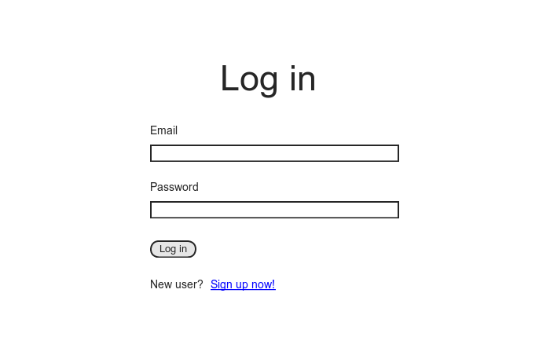
exercise 2: code this mockup into a website

Slide 11
Work on project

